Slide 1
[TITLE HERE]
Financial Literacy by BR-LIFE of AIA

Slide 2
COURSE OBJECTIVE
Plan how to grow your business and reach your short and long-term business goals successfully.
Assisting you in making better financial decisions about the location, inventory, employees and equipment you can afford.
Helping you with understanding your personal finance to determine whether you are in a good financial position to start a business.

Slide 3
Course Outline
PART 1:
Understanding Your Financial Health
PART 2:
Starting Up Your Business

Slide 4
PART 1
UNDERSTANDING YOUR FINANCIAL HEALTH

Slide 5
MODULE OUTLINE
1. BUDGETING
2. SAVINGS
3. FINANCIAL HEALTH CHECK
(FHC)

Slide 6
FINANCIAL PLANNING
“FINANCIAL PLANNING IS THE PROCESS OF MEETING YOUR LIFE GOALS THROUGH THE PROPER MANAGEMENT OF YOUR FINANCES”
-CERTIFIED FINANCIAL BOARD OF STANDARDS, INC

Slide 7
BUDGETING
Definition and benefits
What is a budget?
A tool to track when and how you earn or spend money over a period of time which is an ongoing process. Recommended to revisit and rework your budget monthly..
A budget can help you:
Set short- and long-term goals for business growth.
Track revenue, expenses and cash flow.
Trim costs to avoid overspending.
Notes:
What is a budget and why is it important?
A budget is a tool to track when and how you earn or spend money over a period of time. Creating a budget is an important pillar of your overall success. It allows you to oversee and better understand whether your business has enough revenue (incoming money) to pay its expenses. Using a budget can help you make more fast and accurate financial decisions.
For example, if you know how much money you earned and spent every week for the last several months, you’ll know how much you can afford to spend if you want to hire a new employee.
Budgeting is an ongoing process rather than a one-time exercise because your business revenue and expenses could change at any time. Revisit and rework your budget monthly, quarterly or after changes to your business, such as big expenses, occur. This will help you stay on track to achieve your goals.
A budget can help you:
Set short- and long-term goals for business growth
Track revenue, expenses and cash flow
Trim costs to avoid overspending
Revenue
The actual amount of money received through business activities, including selling products, investments, interest on savings, dividends and other sources.
Expenses
All costs associated with running a business, including direct costs (materials or supplies), recurring expenses (rent or electricity), long-term assets that will help your business for years, but are harder to sell (buildings or equipment), and financial expenses, such as loan or interest payments. Expenses can be categorized in two groups:
Fixed expenses, which stay the same from month to month, such as rent, salaries, insurance and accounting services.
Flexible expenses, which change from month to month, such as material expenses, inventory expenses, maintenance and repairs expenses.
Profit or Income
The amount remaining after you subtract revenue from expenses.

Slide 8
SAVINGS
What is savings?
Money you set aside to cover future planned or unexpected expenses
Create a budget and stick to it
Save wisely
Pay yourself first
Be ready for the unknown
Set financial goals to stay on track
Notes:
How can you save?
If you’re reluctant to start saving or believe it isn’t possible, think of it as a path to exciting opportunities rather than a burden. Chances are you’ll need the funds for unexpected situations in your business, good and bad. Here are some basic steps to get you started.
Create a budget and stick to it. When you make a monthly budget, consider overestimating your expected costs. This way, you’ll likely end up with leftover funds, which can go right into savings.
Pay yourself first. Determine a set amount of money to put away every month and treat it like any other bill. Put away part of your revenue and watch your personal savings grow.
Save wisely. Choose the savings methods that best match your goals. You can research multiple financial institutions to see what types of accounts are available and how much interest each one offers.
Be ready for the unknown. Create an emergency fund with three to six months’ worth of business expenses. All businesses encounter hard times. With savings to help you get through three to six months, you’ll be more equipped to make sure your business stays open.
Set financial goals to stay on track. Use SMART goals so you know exactly how much you want to save and how long it will take to get there. When you set clear goals, it’s easier to stay motivated and track your progress.

Slide 9
SAVINGS
Set saving goals
Determine a reason to save.
Think about short-term goals and long-term objectives (for important events and big expenses) using this SMART goals guideline:
Specific
Measurable
Attainable
Relevant
Time-bound
Clear goal with specific outcomes
Can measure your progress along the way
Ensure it is within your reach
Set a goal only if you know it will be meaningful
Set a time frame for your goal
Notes:
Set saving goals
Before settling on methods for saving your money, you should determine a reason to save. This goal may center around purchasing new equipment, hiring more employees, making improvements to your place of business, or simply saving for unplanned expenses. Having this end goal in sight will help you reach that milestone. To jump-start your savings, consider designating a certain amount per month rather than just a one-time deposit.
SMART goals
Real-life reasons to save are good motivators. Think about short-term goals (current month or year purchases) and long-term objectives (for important events and big expenses) using this SMART goal guideline:
Specific goals inspire. Setting a clear goal with specific outcomes will help you focus on saving.
Measurable goals let you see the real task at hand. By using real numbers, you can measure your progress along the way.
Attainable goals pay off. When setting your goal, ensure that it is within your reach.
Relevant goals make good sense. Set a goal only if you know it will be meaningful in the long run.
Time-bound goals have a real deadline. Setting a time frame for your goal will help you stay committed to reaching it.
Once you’ve set your financial goals, it’s time to start saving. Choosing the right savings method is dependent on a few factors: how much money you hope to save, how you will access your funds and when you’ll want to withdraw them. The first step is evaluating the options available.

Slide 10
SAVINGS
EXAMPLE
Set saving goals
Ali’s saving goal:
Save $15,000 BND in the next 2 years (after he retires) to start a small business.
Why is it SMART?
Specific
Measurable
Attainable
Relevant
Time-bound
Saving $15,000 to start a small business
Ali can track his progress by aiming to save $625 permonth.
His income and expense analysis show they can realistically save the targeted amount each month.
He can cook and beneficial for his extra income
Setting a specific timeframe of 24 months to achieve the goal

Slide 11
FINANCIAL HEALTH CHECK (FHC)
Definition
A financial health check is a way of assessing how well an individual or organization is doing financially. It involves looking at money management, income, spending, savings, investments, debts, and overall financial habits to understand their overall financial well-being.
Benefits
Regular financial health checks are important for individuals and businesses alike. They help identify areas that need attention, prevent financial crises, and allow for adjustments to financial plans as circumstances change
Notes:
financial advisors or planners, often assist individuals or organizations in conducting comprehensive financial health checks.

Slide 12
‘ARE YOU
FINANCIALLY HEALTHY?’
LET’S DO FINANCIAL HEALTH CHECK TO SEE IF YOU ARE FINANCIALLY READY TO START A BUSINESS

Slide 13
COMPONENTS OF
FINANCIAL HEALTH
CHECK
ASSETS
EVERYTHING THAT YOU OWN
LIABILITIES
EVERYTHING THAT YOU OWE
Notes:
Do “components of FHC”.
Knowing your assets
Knowing your liabilities.

Slide 14
ASSETS
LIABILITIES
MONTHLY INCOME
EXPENSES
House
Land
Motor Vehicle
Home Contents
Managed Investments
TAP + SCP / SPK
Cash Savings
House Loan
Car Loan
Renovation Loan
Personal Loan
Credit Card
Other Loans
Employment Salary
Investment
Allowances (SPK, SCP)
Business
Regular Savings
Monthly Loans
Groceries & Utilities
Phone Bilss
Family Support
Education Fees
Transportation
Subscription (Membership, Netflix, etc)
Personal Leisure
Insurance Premiums
Other Expenses (Maid, Pets)

Slide 15
UNDERSTANDING YOUR PERSONAL FINANCES
MONTHLY CASH FLOW
THE MOVEMENT OF YOUR MONEY EVERY MONTH.(SURPLUS/SHORTFALL)
NET WORTH
A MEASURE OF PERSONAL WEALTH

Slide 16
SAVINGS RATIO
INDICATES THE PERCENTAGE OF SAVINGS VS. TAKE-HOME INCOME
BASIC LIQUIDITY RATIO
SHOWS THE NUMBER OF MONTHS YOU CAN SUSTAIN YOUR EXPENSES, IF INCOME IS LOST.
DEBT SERVICE RATIO
SHOW HOW MUCH OF YOUR NET INCOME PER MONTH IS BEING USED TO SERVICE DEBT.
UNDERSTANDING YOUR PERSONAL FINANCES

Slide 17
FINANCIAL HEALTH CHECK FOR YOURSELF
SAVINGS RATIO
= Monthly Savings ÷ total monthly Income
x 100%
DEBT SERVICE RATIO
= Total Monthly Loan ÷
Total Monthly Income
BASIC LIQUIDITY RATIO
= Total Cash Savings ÷
Monthly Expenses

Slide 18
FINANCIAL HEALTH CHECK FOR YOURSELF
SAVINGS RATIO
= Monthly Savings ÷ total monthly Income
x 100%
DEBT SERVICE RATIO
= Total Monthly Loan ÷
Total Monthly Income
BASIC LIQUIDITY RATIO
= Total Cash Savings ÷
Monthly Expenses
10%
35%
3 - 6

Slide 19
KEY MESSAGES
Budgeting is essential for tracking income and expenses, enabling better financial management.
Saving allows for preparedness, future growth, and the ability to navigate unexpected challenges.
Regular financial analysis helps assess the financial health of your business and make informed decisions.

Slide 20
‘ARE YOU
FINANCIAL HEALTHY
TO START YOUR OWN BUSINESS?’

Slide 21
PART 2
STARTING UP YOUR
BUSINESS

Slide 22
MODULE OUTLINE
1. LOANS
2. BUSINESS DIGITIZATION

Slide 23
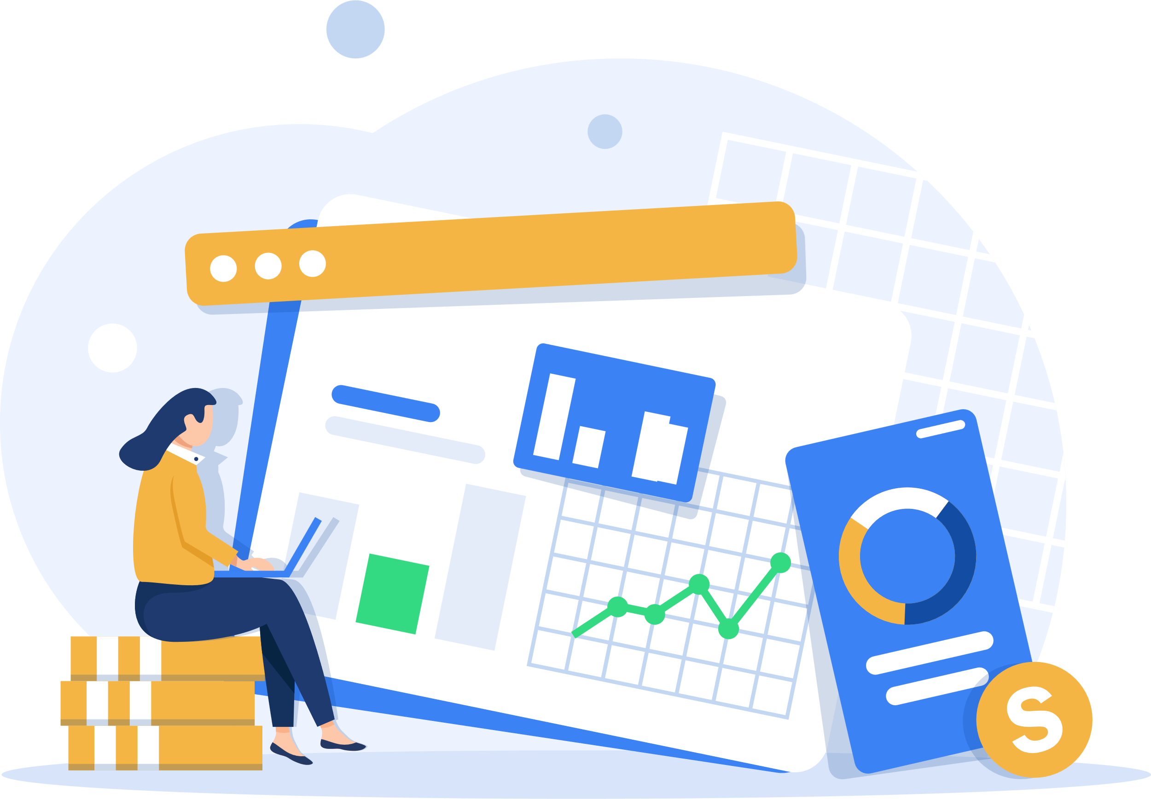
1. LOANS
Funding your business is one of the first - and most important - financial choices you're likely to make as the owner.
How you choose to fund your business can affect everything from its structure to operations.
If you take out a large loan, you’ll need to earn enough money to repay the loan while running your business.
Notes:
It costs money to start a business, and funding your business is one of the first — and most important — financial choices you're likely to make as the owner. Keep in mind that how you choose to fund your business can affect everything from its structure to operations.

Slide 24
LOANS
Loans Options
Self-funding
Friends/Family
Bank Loans
Investor
Notes:
Self-funding
Friends & Family
These investors know you, the skills you bring, and your passion for the business.
Be sure to thoroughly explain the risk they’re taking by supplying funds.
Loans
Compare interest rates, repayment lengths and potential loan amounts among financial institutions.
Require you to show your business plan and a financial documents.
Investors
Venture capitalists: offer larger loans to established businesses in exchange for partial ownership and an active role in the company.
Angel investors: focus on helping businesses that are just starting out with small investments.
Seller financing
You pay for a portion of the purchase upfront (down payment) and borrow the rest of the money from the seller. Then repay the loan, plus interest, over time.
Crowdfunding
3 basic types: Donations, Rewards & Equity.
A great way to increase awareness and exposure, there are risks associated with it as well.

Slide 25
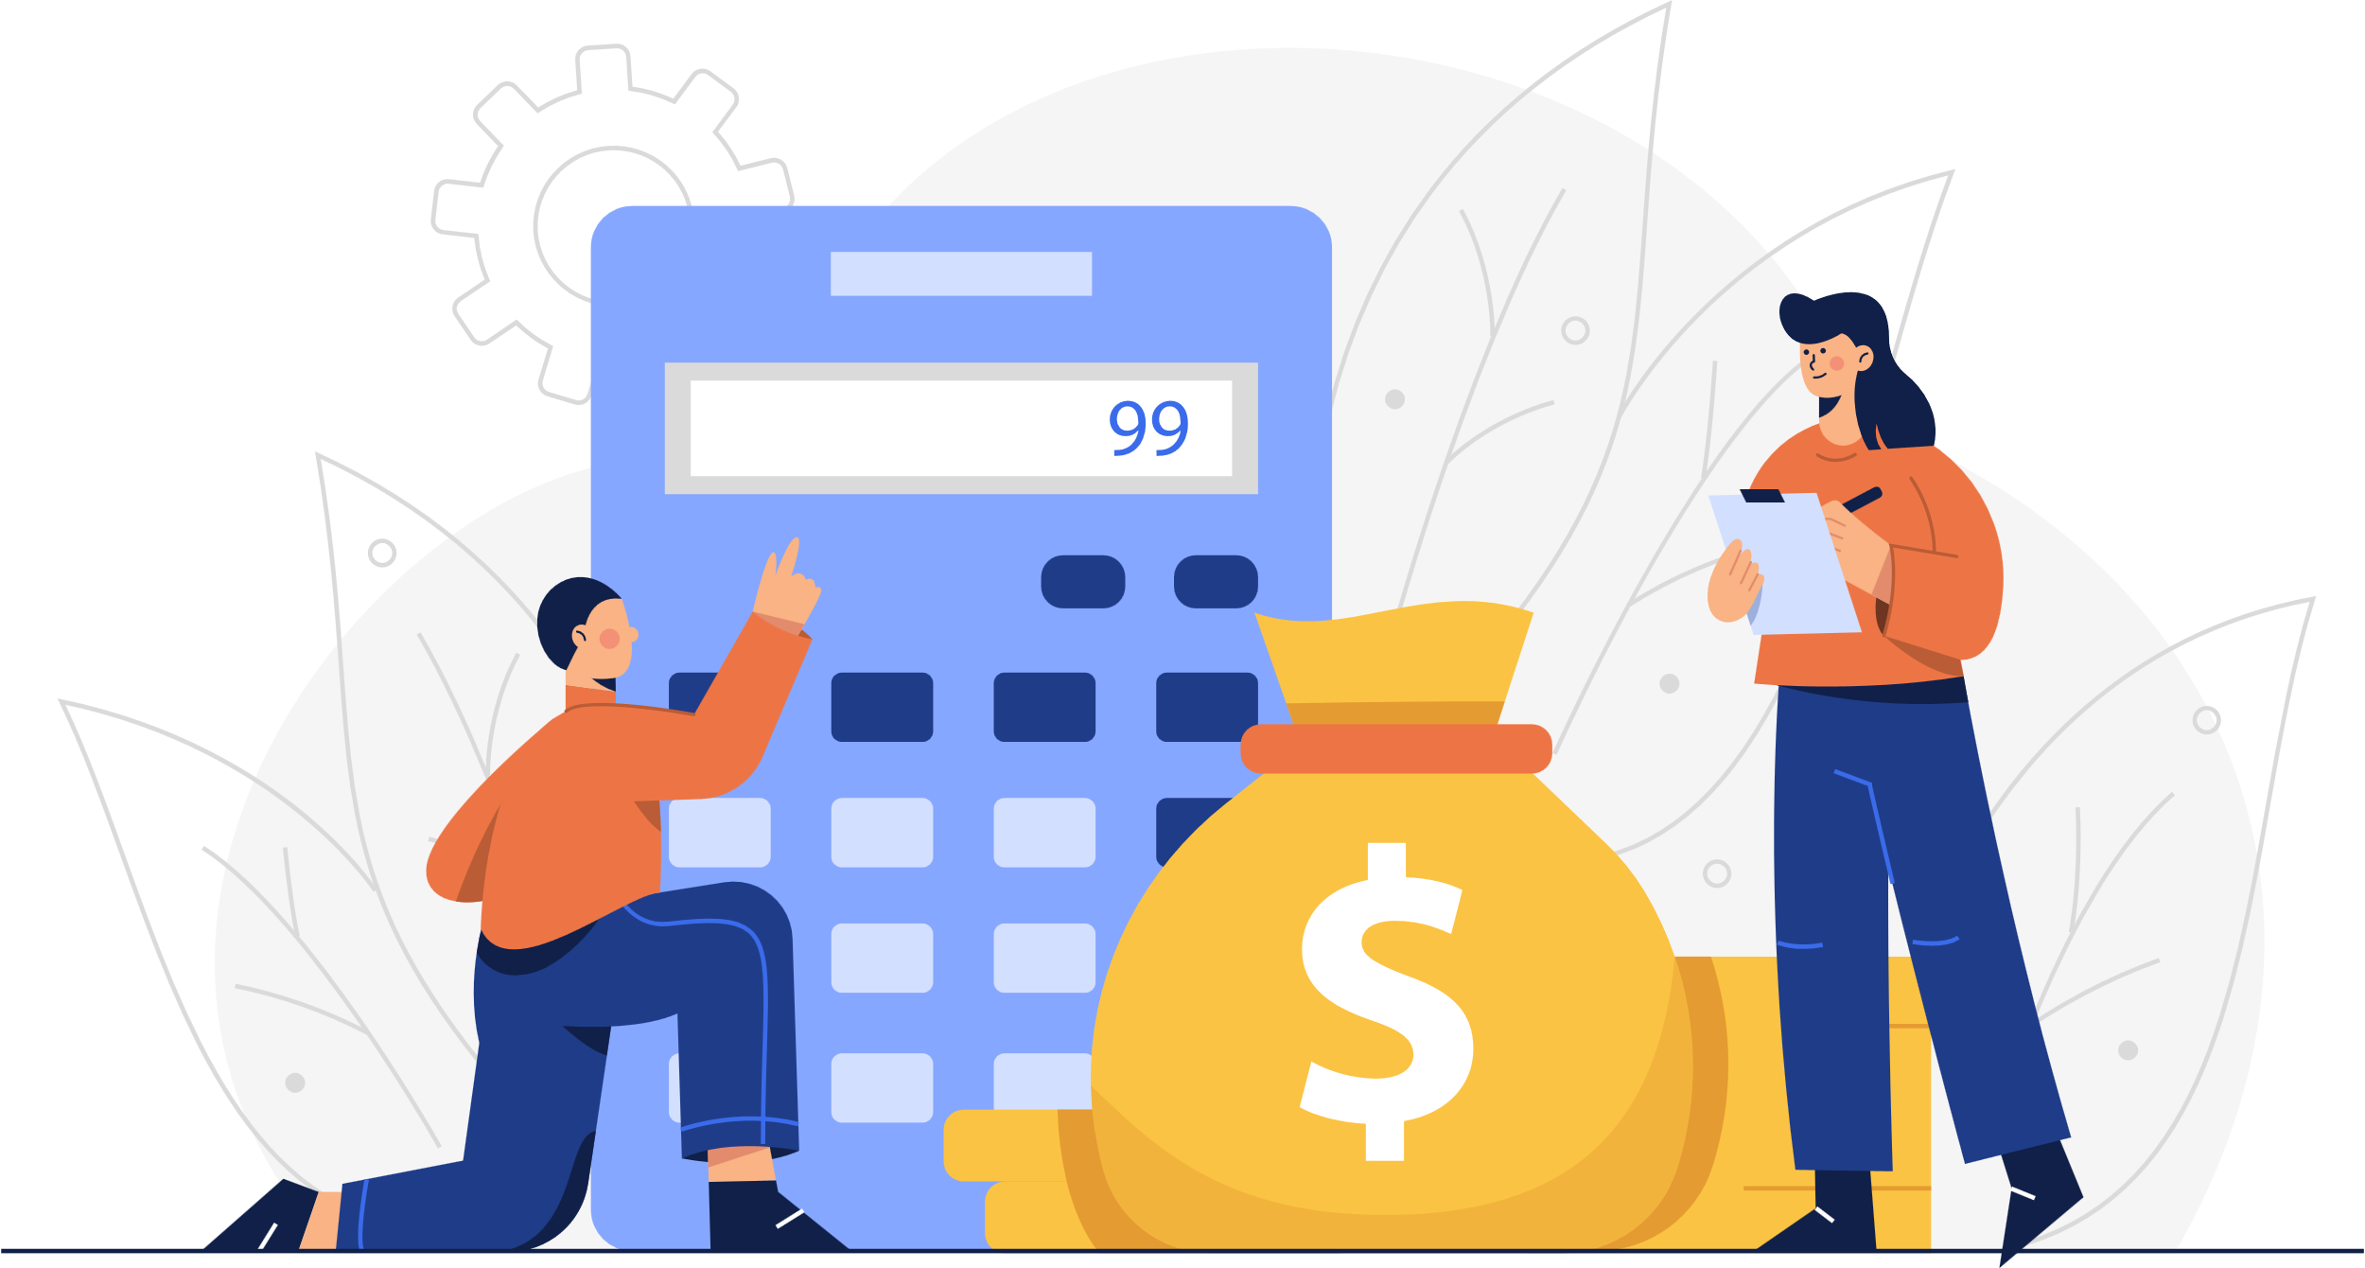
FINANCING
Debt
Necessary for many small business owners, especially when they're first starting out.
But interest payments are also a business expense that take away from your profits and can cause uncertainty.
Figure out when you should borrow money, and where you should borrow money from
Business credits
Before a company lends you money, it wants to know that you're capable and willing to repay the debt.
Lenders may want to determining your business credit score.
Notes:
Debt may be necessary for many small business owners, especially when they're first starting out. Borrowing money can help you open and run your business, but interest payments are also a business expense that take away from your profits and can cause uncertainty.
In time, it's possible to get on solid financial ground and run a profitable, debt-free business. Alternatively, some business owners find that they can use debt to invest in their business and make more money than they spend on interest or fees.
Either option can lead to success. In both cases, figuring out when you should borrow money, and where you should borrow money from, are important skills for business owners.

Slide 26
Are you eligible to take bank loans?
✓ NO DEBT
✓ NEVER EXPERIENCED BANKRUPTCY
✓ ABLE TO PAY LOAN MONEY
✓ PAY BILLS ON TIME
✓ HAVE EMERGENCY SAVINGS
X HAS A LOT OF DEBT
X BORROWS AN UNREALISTIC AMOUNT
X DOES NOT MEET THE REQUIREMENTS OF THE BORROWER
X DOES NOT HAVE EMERGENCY MONEY
Notes:
Loan - where we can get loans - credibility (credit score

Slide 27
2. BUSINESS DIGITIZATION
Profit & Loss Statement
Inventory Management
Record-Keeping
GOOGLE
DRIVE
Notes:
Self-funding
Friends & Family
These investors know you, the skills you bring, and your passion for the business.
Be sure to thoroughly explain the risk they’re taking by supplying funds.
Loans
Compare interest rates, repayment lengths and potential loan amounts among financial institutions.
Require you to show your business plan and a financial documents.
Investors
Venture capitalists: offer larger loans to established businesses in exchange for partial ownership and an active role in the company.
Angel investors: focus on helping businesses that are just starting out with small investments.
Seller financing
You pay for a portion of the purchase upfront (down payment) and borrow the rest of the money from the seller. Then repay the loan, plus interest, over time.
Crowdfunding
3 basic types: Donations, Rewards & Equity.
A great way to increase awareness and exposure, there are risks associated with it as well.

Slide 28
BUSINESS DIGITIZATION
What is business digitization?
Involves using a variety of technologies to increase efficiency (converting paper processes to digital ones).
Ways you can digitize your business:
Sending electronic invoices
Promoting your business online
Signing up for online banking
Notes:
Why digitization?
Can help cut costs and save you time.
Provides solutions to organizational problems, allowing business owners to gain more control over their business operations.
Helps you maintain a competitive edge and improve the efficiency of your business.

Slide 29
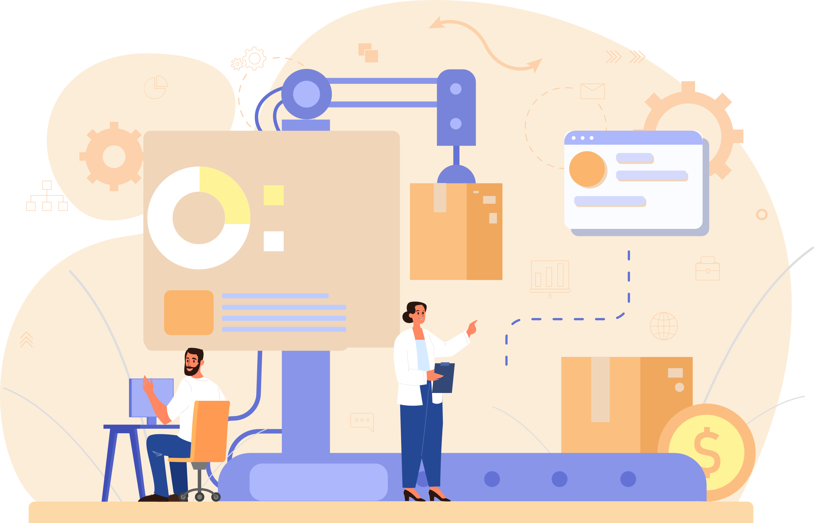
BUSINESS DIGITIZATION
Online promotions
Helps you reach more customers and increase your earnings.
Could be in the form of a website, digital marketing and social media e.g Instagram.
Try creating different ads and giving each one a unique promotion code, then track the codes that customers use.
Digital advertising able to target the specific types of people who are most likely to become your customers.
Notes:
Introducing digital promotion opportunities to your business could help you reach more customers and increase your earnings. This could take the form of a website, digital marketing and other digital promotions.
Take your marketing and promotions online
You can use a variety of marketing and promotional tools and tactics to grow your business. For example, you could try creating different ads and giving each one a unique promotion code. You can then track the codes that customers use, which helps you understand which ads are worth continuing and which you should stop paying for.
With digital advertising, you can also target the specific types of people who are most likely to become your customers, helping you make the most of your marketing budget.

Slide 30
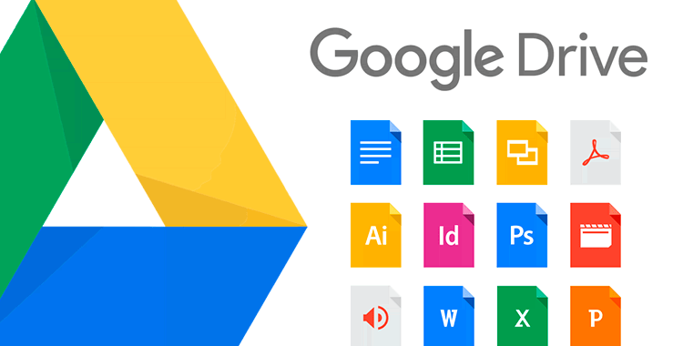
BUSINESS DIGITIZATION
Google Drive
What is Google Drive?
How can a business use Google Drive?
A storage service that functions as a cloud-based external hard-drive.
Uploading and downloading files, organizing in intuitive folder structures and sharing with the right people.
Common ways:
Storing reports and policy documents
Sharing media assets, such as photos, logos, and press releases
Gathering images and other media files to keep handy in the workflow
Notes:
What is Google Drive?
Google Drive is a storage service that functions as a cloud-based external hard-drive. You can easily store, manage, and share content such as documents, images, and audio files.
Uploading and downloading files as you need them, organize them in intuitive folder structures, and share them with the right people.
Google Drive’s intuitive interface and integration with other Google apps have made it convenient for private use as well as small- and medium-sized businesses and startups.
Using Google Drive for Knowledge Management
Google Drive can be the first step in the right direction of ensuring that organizational knowledge is properly stored and shared. Gathering content in one place helps improve the issue with information silos, where important documents and content become stuck on hard drives or in someone’s email inbox.
So, how can a business use Google Drive? Common ways of using it include:
Storing reports and policy documents
Sharing media assets, such as photos, logos, and press releases
Gathering images and other media files to keep handy in the workflow

Slide 31
PROFIT AND LOSS STATEMENT
What is a profit and loss statement?
Also known as income statement, or revenue statement.
Helps you understand if and how your business is making or losing money, along with the different types of expenses you’re paying.
Profit (Net income) = Income (Revenue) - Expenses
Notes:
While the balance sheet gives you a snapshot of your business’s finances, the profit and loss (P&L) statement gives you insight into how your business has done over a period of time.
The profit and loss statement can go by several other names, such as income statement, or revenue statement. These are all the same thing.
You can use your P&L to figure out if you made or lost money over a certain period, and you can create a profit and loss statement for different periods, such as a month, quarter, year or multiple years.
From an income statement and other financial documents, you can determine:
(1) Whether the business is generating a profit
(2) If it’s spending more than it earns
(3) When costs are highest and lowest
(4) How much it’s paying to produce its product
(5) If it has the cash to invest back into the business
Your P&L statement should break down your sources of income or expenses, which can help you understand where your business is making or losing money.
For example, if you notice your expenses for repairs and maintenance are increasing month after month, you may want to consider investing in brand new equipment. Or, if your sales start to decline, perhaps it’s time to reexamine your marketing campaign or which products and services you’re selling.

Slide 32
RECORD-KEEPING
What is record-keeping?
Record-keeping is the process of keeping ALL records of a business
How can record-keeping help you?
Know how much money to invest to create your product or service
Set pricing
Compare budgeted amounts to actual costs
Track spending
Make wise decisions about purchases
Access customer & employee information easily
Notes:
For small business owners everywhere, record-keeping and book-keeping is a necessary and sometimes tricky part of making sure a business runs smoothly. Record-keeping is the process of keeping ALL records of a business while Book-keeping refers to the recording of financial information of a business.
Keeping clear records of income, expenses, employees, and accounts isn’t just good business. It can bring you peace of mind, help you monitor progress toward goals and save you time and money.
Basic records include:
Business expenses
Sales records
Accounts receivable
Accounts payable
Customer list
Vendors
Employee information
Tax documents
Invoices
Purchase orders
Receipts
Bank statements
Contracts

Slide 33
RECORD-KEEPING
Example of Record-Keeping of a fashion business

Slide 34
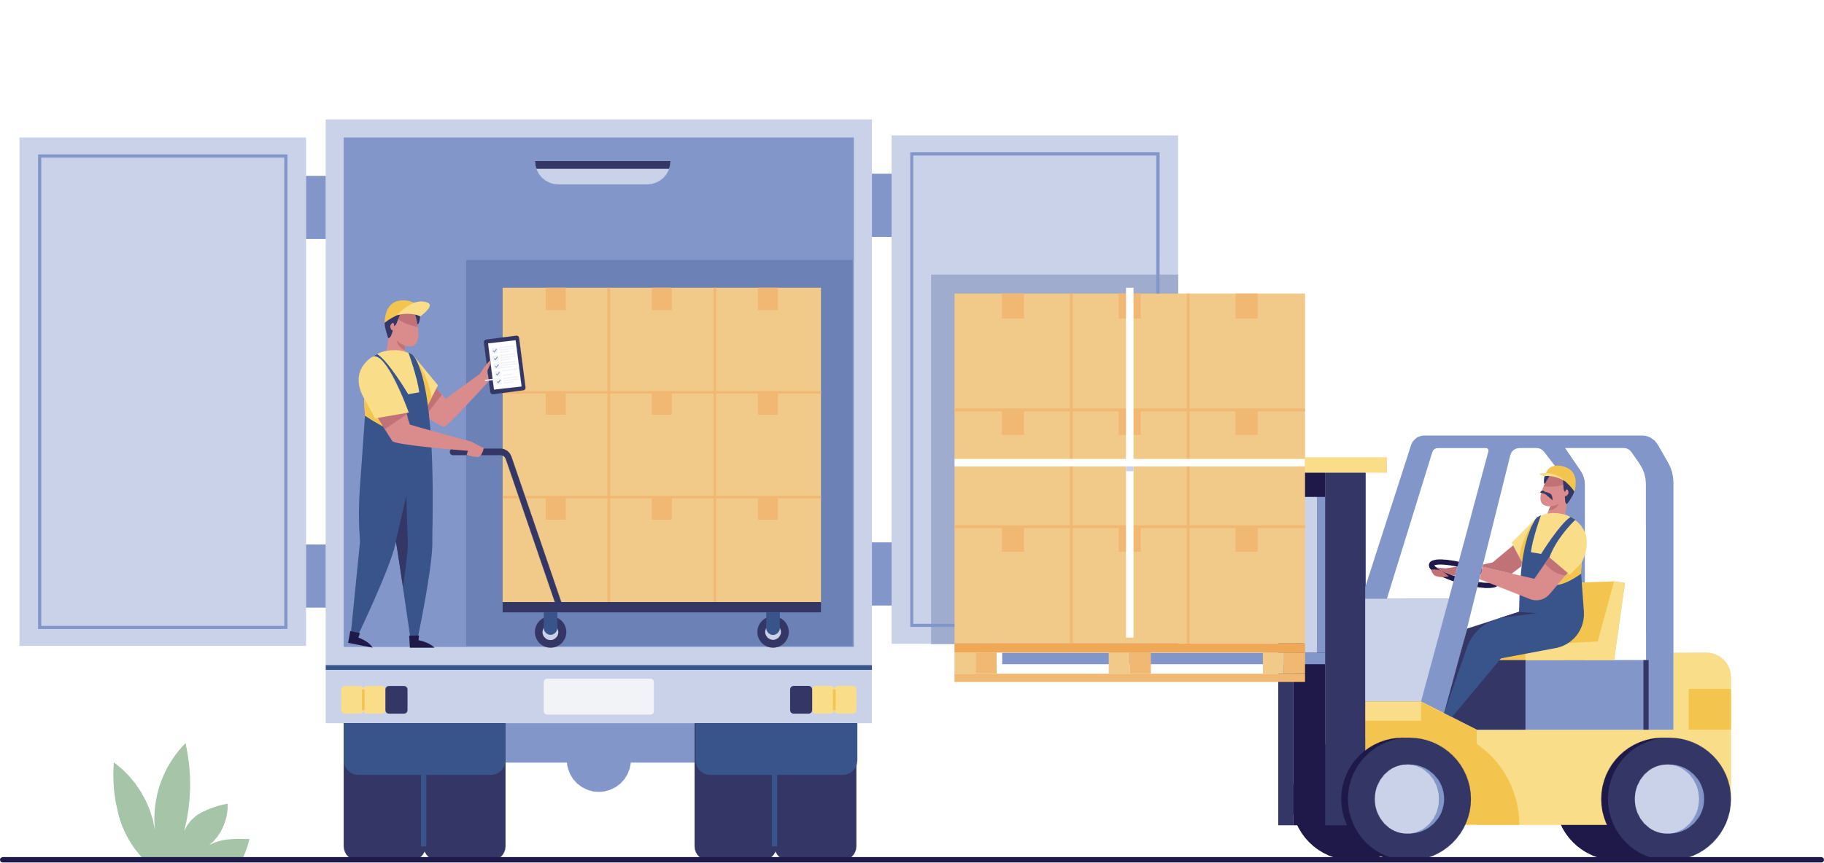
MANAGING INVENTORY
What is managing inventory?
Record products manufactured or purchased, shipped, delivered and returned.
Inventory Management Systems:
Determine the quantity to order
Determine when to order
Keep track of the orders
Receive, handle, tag, and store the orders
Focus on TWO decisions:
WHEN to order
HOW MUCH to order
Notes:
Keeping track of your inventory can help prevent you from potential inventory errors or inefficiencies. You can increase profits and operate more efficiently by keeping careful track of the goods your company has in stock. To do so, record products manufactured or purchased, shipped, delivered and returned.
Why is managing inventory important?
Help prevent you from potential inventory errors or inefficiencies.
Increase profits and operate more efficiently.
Make sure you can fill orders without delays or becoming overwhelmed.
Help you stay organized, maintain accuracy, save you time and money, increase efficiency and productivity, and keep your customers satisfied.

Slide 35
KEY MESSAGES
Keeping accurate and organized records is essential for the financial success of your business.
Key financial performance measurements help evaluate the company's profitability, efficiency, liquidity, and solvency, aiding in decision-making and monitoring financial health.
Analyzing financial statements informs decision-making and strategic planning for the business.

Slide 36
+673 818 5796
@brlifeagency
www.brlifeagency.com
with support from

