Slide 1
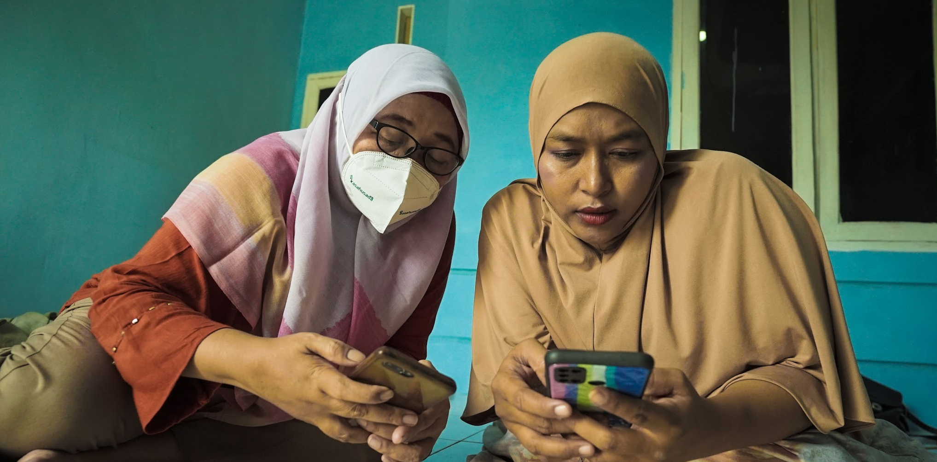
[TITLE HERE]
Literasi Kewangan disampaikan oleh BR-LIFE AIA

Slide 2
COURSE OBJECTIVE
Rancang bagaimana untuk memajukan perniagaan biskita dan mencapai matlamat perniagaan dengan berjaya.
Membantu biskita membuat keputusan kewangan yang lebih baik
Menolong biskita memahami kewangan peribadi biskita untuk menentukan sama ada biskita berada dalam kedudukan kewangan yang baik untuk memulakan perniagaan

Slide 3
KANDUNGAN KURSUS
BAHAGIAN 1:
Memahami Kesihatan Kewangan Biskita
BAHAGIAN 2:
Memulakan Perniagaan Biskita

Slide 4
BAHAGIAN 1
MEMAHAMI KESIHATAN KEWANGAN BISKITA

Slide 5
RANGKA MODUL
1. BAJET
2. SIMPANAN
3. KESIHATAN KEWANGAN (FHC)

Slide 6
PERANCANGAN KEWANGAN
"Perancangan kewangan adalah proses mencapai matlamat hidup biskita melalui pengurusan kewangan yang betul."
-CERTIFIED FINANCIAL BOARD OF STANDARDS, INC
Notes:
What is a budget and why is it important?
A budget is a tool to track when and how you earn or spend money over a period of time. Creating a budget is an important pillar of your overall success. It allows you to oversee and better understand whether your business has enough revenue (incoming money) to pay its expenses. Using a budget can help you make more fast and accurate financial decisions.
For example, if you know how much money you earned and spent every week for the last several months, you’ll know how much you can afford to spend if you want to hire a new employee.
Budgeting is an ongoing process rather than a one-time exercise because your business revenue and expenses could change at any time. Revisit and rework your budget monthly, quarterly or after changes to your business, such as big expenses, occur. This will help you stay on track to achieve your goals.
A budget can help you:
Set short- and long-term goals for business growth
Track revenue, expenses and cash flow
Trim costs to avoid overspending
Revenue
The actual amount of money received through business activities, including selling products, investments, interest on savings, dividends and other sources.
Expenses
All costs associated with running a business, including direct costs (materials or supplies), recurring expenses (rent or electricity), long-term assets that will help your business for years, but are harder to sell (buildings or equipment), and financial expenses, such as loan or interest payments. Expenses can be categorized in two groups:
Fixed expenses, which stay the same from month to month, such as rent, salaries, insurance and accounting services.
Flexible expenses, which change from month to month, such as material expenses, inventory expenses, maintenance and repairs expenses.
Profit or Income
The amount remaining after you subtract revenue from expenses.

Slide 7
Notes:
What is a budget and why is it important?
A budget is a tool to track when and how you earn or spend money over a period of time. Creating a budget is an important pillar of your overall success. It allows you to oversee and better understand whether your business has enough revenue (incoming money) to pay its expenses. Using a budget can help you make more fast and accurate financial decisions.
For example, if you know how much money you earned and spent every week for the last several months, you’ll know how much you can afford to spend if you want to hire a new employee.
Budgeting is an ongoing process rather than a one-time exercise because your business revenue and expenses could change at any time. Revisit and rework your budget monthly, quarterly or after changes to your business, such as big expenses, occur. This will help you stay on track to achieve your goals.
A budget can help you:
Set short- and long-term goals for business growth
Track revenue, expenses and cash flow
Trim costs to avoid overspending
Revenue
The actual amount of money received through business activities, including selling products, investments, interest on savings, dividends and other sources.
Expenses
All costs associated with running a business, including direct costs (materials or supplies), recurring expenses (rent or electricity), long-term assets that will help your business for years, but are harder to sell (buildings or equipment), and financial expenses, such as loan or interest payments. Expenses can be categorized in two groups:
Fixed expenses, which stay the same from month to month, such as rent, salaries, insurance and accounting services.
Flexible expenses, which change from month to month, such as material expenses, inventory expenses, maintenance and repairs expenses.
Profit or Income
The amount remaining after you subtract revenue from expenses.

Slide 8
Notes:
What is a budget and why is it important?
A budget is a tool to track when and how you earn or spend money over a period of time. Creating a budget is an important pillar of your overall success. It allows you to oversee and better understand whether your business has enough revenue (incoming money) to pay its expenses. Using a budget can help you make more fast and accurate financial decisions.
For example, if you know how much money you earned and spent every week for the last several months, you’ll know how much you can afford to spend if you want to hire a new employee.
Budgeting is an ongoing process rather than a one-time exercise because your business revenue and expenses could change at any time. Revisit and rework your budget monthly, quarterly or after changes to your business, such as big expenses, occur. This will help you stay on track to achieve your goals.
A budget can help you:
Set short- and long-term goals for business growth
Track revenue, expenses and cash flow
Trim costs to avoid overspending
Revenue
The actual amount of money received through business activities, including selling products, investments, interest on savings, dividends and other sources.
Expenses
All costs associated with running a business, including direct costs (materials or supplies), recurring expenses (rent or electricity), long-term assets that will help your business for years, but are harder to sell (buildings or equipment), and financial expenses, such as loan or interest payments. Expenses can be categorized in two groups:
Fixed expenses, which stay the same from month to month, such as rent, salaries, insurance and accounting services.
Flexible expenses, which change from month to month, such as material expenses, inventory expenses, maintenance and repairs expenses.
Profit or Income
The amount remaining after you subtract revenue from expenses.

Slide 9
Notes:
What is a budget and why is it important?
A budget is a tool to track when and how you earn or spend money over a period of time. Creating a budget is an important pillar of your overall success. It allows you to oversee and better understand whether your business has enough revenue (incoming money) to pay its expenses. Using a budget can help you make more fast and accurate financial decisions.
For example, if you know how much money you earned and spent every week for the last several months, you’ll know how much you can afford to spend if you want to hire a new employee.
Budgeting is an ongoing process rather than a one-time exercise because your business revenue and expenses could change at any time. Revisit and rework your budget monthly, quarterly or after changes to your business, such as big expenses, occur. This will help you stay on track to achieve your goals.
A budget can help you:
Set short- and long-term goals for business growth
Track revenue, expenses and cash flow
Trim costs to avoid overspending
Revenue
The actual amount of money received through business activities, including selling products, investments, interest on savings, dividends and other sources.
Expenses
All costs associated with running a business, including direct costs (materials or supplies), recurring expenses (rent or electricity), long-term assets that will help your business for years, but are harder to sell (buildings or equipment), and financial expenses, such as loan or interest payments. Expenses can be categorized in two groups:
Fixed expenses, which stay the same from month to month, such as rent, salaries, insurance and accounting services.
Flexible expenses, which change from month to month, such as material expenses, inventory expenses, maintenance and repairs expenses.
Profit or Income
The amount remaining after you subtract revenue from expenses.

Slide 10
SIMPANAN
CONTOH
Menetap Matlamat Simpanan
Matlamat Simpanan Ali:
Untuk menyimpan $15,000 selama 2 tahun sehingga pencen untuk memulakan perniagaan gerai makanan
Melalui SMART:
Specific
(khusus)
Measurable
(dapat diukur)
Attainable
(boleh dicapai)
Relevant
(penting)
Time-bound
(terikat pada masa)
Menyimpan $15,000 untuk memulakan perniagaan kecil
Menyasarkan untuk menjimatkan $625 sebulan
Pendapatan Ali boleh menyimpan $625 setiap bulan secara realistik
Ali boleh memasak dan bermanfaat untuk pendapatan tambahan
Menetapkan jangka masa tertentu (24 bulan )

Slide 11
Pemeriksaan Kesihatan Kewangan (FHC)
Definasi
Pemeriksaan kesihatan kewangan adalah cara untuk menilai sejauh mana individu atau organisasi berada dalam keadaan kewangan. Ia melibatkan pemerhatian pengurusan wang, pendapatan, perbelanjaan, simpanan, pelaburan, hutang, dan tabiat kewangan keseluruhan untuk memahami keadaan kewangan keseluruhan mereka.
Kelebihan
Pemeriksaan kesihatan kewangan secara berkala adalah penting untuk individu dan perniagaan. Ia membantu mengenal pasti bidang yang memerlukan perhatian, mencegah krisis kewangan, dan membolehkan penyesuaian kepada rancangan kewangan mengikut perubahan keadaan.
Notes:
financial advisors or planners, often assist individuals or organizations in conducting comprehensive financial health checks.

Slide 12
‘ADAKAH BISKITA SIHAT DALAM KEWANGAN?’
MARI LAKUKAN PEMERIKSAAN KESEHATAN KEWANGAN UNTUK MELIHAT SAMADA BISKITA SIAP KEWANGAN UNTUK MEMULAKAN PERNIAGAAN.

Slide 13
KOMPONEN PEMERIKSAAN KESIHATAN KEWANGAN
ASET
SEMUA YANG AWDA MILIKI
LIABILITI
SEMUA YANG AWDA HUTANG
Notes:
Do “components of FHC”.
Knowing your assets
Knowing your liabilities.

Slide 14
ASET
LIABILITI
PENDAPATAN
PERBELANJAAN
RUMAH
TANAH
KERETA
BARANG RUMAH
PELABURAN
TAP + SCP / SPK
WANG SIMPANAN
HUTANG RUMAH
HUTANG KERETA
HUTANG HOUSE
HUTANG PEMBAHARUAN RUMAH
PINJAMAN PERIBADI
KAD KREDIT
HUTANG PINJAMAN LAIN
GAJI PEKERJAAN
PELABURAN
ELAUN (SPK, SCP)
PERNIAGAAN
PENCEN TUA
SIMPANAN BULANAN
PINJAMAN BULANAN
BARANGAN RUNCIT & UTILITI
BIL TELEFON
IBU BAPA / KELUARGA
YURAN PENDIDIKAN
PENGANGKUTAN
LANGGANAN (JIM, NETFLIX, DLL)
PERIBADI/SENIKMAT
PREMIUM INSURANS
PERBELANJAAN LAIN (PEMBANTU, DATA TELEFON, DLL)

Slide 15
ASET
LIABILITI
PENDAPATAN
PERBELANJAAN
RUMAH
TANAH
KERETA
BARANG RUMAH
PELABURAN
TAP + SCP / SPK
WANG SIMPANAN
HUTANG RUMAH
HUTANG KERETA
HUTANG HOUSE
HUTANG PEMBAHARUAN RUMAH
PINJAMAN PERIBADI
KAD KREDIT
HUTANG PINJAMAN LAIN
GAJI PEKERJAAN
PELABURAN
ELAUN (SPK, SCP)
PERNIAGAAN
PENCEN TUA
SIMPANAN BULANAN
PINJAMAN BULANAN
BARANGAN RUNCIT & UTILITI
BIL TELEFON
IBU BAPA / KELUARGA
YURAN PENDIDIKAN
PENGANGKUTAN
LANGGANAN (JIM, NETFLIX, DLL)
PERIBADI/SENIKMAT
PREMIUM INSURANS
PERBELANJAAN LAIN (PEMBANTU, DATA TELEFON, DLL)
ASET - LIABILITI =
PENDAPATAN - PERBELANJAAN
= LEBIH / KURANG
TINGGI / RENDAH

Slide 16
Pemeriksaan Kesihatan Kewangan Untuk Diri Biskita Sendiri
SAVINGS RATIO
(RATIO SIMPANAN)
= Bulanan Simpanan ÷ Pendapatan Bulanan
x 100%
DEBT SERVICE RATIO
(RATIO PERKHIDMATAN HUTANG)
= Jumlah Bayaran Bulanan ÷
Pendapatan Bulanan
BASIC LIQUIDITY RATIO
(RATIO LIKIT ASAS)
= Jumlah Simpanan ÷ Perbelanjaan Bulanan

Slide 17
Pemeriksaan Kesihatan Kewangan Untuk Diri Biskita Sendiri
SAVINGS RATIO
(RATIO SIMPANAN)
= Bulanan Simpanan ÷ Pendapatan Bulanan
x 100%
DEBT SERVICE RATIO
(RATIO PERKHIDMATAN HUTANG)
= Jumlah Bayaran Bulanan ÷
Pendapatan Bulanan
BASIC LIQUIDITY RATIO
(RATIO LIKIT ASAS)
= Jumlah Simpanan ÷ Perbelanjaan Bulanan
10%
35%
3 - 6

Slide 18
‘ADAKAH KEWANGAN BISKITA SIHAT UNTUK MEMULAKAN PERNIAGAAN SENDIRI?’

Slide 19
BAHAGIAN 2
MEMULAKAN PERNIAGAAN

Slide 20
RANGKA MODUL
1. PEMBIAYAAN
2. PERNIAGAAN DIGITAL

Slide 21
PEMBIAYAAN
Pilihan Peminjaman
Pembiayaan Sendiri
Keluarga / Kawan
Pinjaman Bank
Pelabur
Notes:
Self-funding
Friends & Family
These investors know you, the skills you bring, and your passion for the business.
Be sure to thoroughly explain the risk they’re taking by supplying funds.
Loans
Compare interest rates, repayment lengths and potential loan amounts among financial institutions.
Require you to show your business plan and a financial documents.
Investors
Venture capitalists: offer larger loans to established businesses in exchange for partial ownership and an active role in the company.
Angel investors: focus on helping businesses that are just starting out with small investments.
Seller financing
You pay for a portion of the purchase upfront (down payment) and borrow the rest of the money from the seller. Then repay the loan, plus interest, over time.
Crowdfunding
3 basic types: Donations, Rewards & Equity.
A great way to increase awareness and exposure, there are risks associated with it as well.

Slide 22
ADAKAH BISKITA DIBOLEHKAN UNTUK ME-LOAN?
✓ TIDAK ADA HUTANG
✓ TIDAK PERNAH MENGALAMI MUFLIS
✓ MAMPU MEMBAYAR DUIT PINJAMAN
✓ MEMBAYAR BIL TEPAT PADA MASANYA
✓ MEMPUNYAI DUIT KECEMASAN
X MEMPUNYAI BANYAK HUTANG
X TIDAK MEMPUNYAI DUIT KECEMASAN
X MEMINJAM JUMLAH YANG TIDAK REALISTIK
X TIDAK MENCUKUPI SYARAT PEMINJAM
Notes:
Loan - where we can get loans - credibility (credit score

Slide 23
2. PERNIAGAAN DIGITAL
Rekod Untung & Rugi
Pengurusan Inventori
Rekod Penyimpanan
NOTA TELEFON
FACEBOOK
Notes:
Self-funding
Friends & Family
These investors know you, the skills you bring, and your passion for the business.
Be sure to thoroughly explain the risk they’re taking by supplying funds.
Loans
Compare interest rates, repayment lengths and potential loan amounts among financial institutions.
Require you to show your business plan and a financial documents.
Investors
Venture capitalists: offer larger loans to established businesses in exchange for partial ownership and an active role in the company.
Angel investors: focus on helping businesses that are just starting out with small investments.
Seller financing
You pay for a portion of the purchase upfront (down payment) and borrow the rest of the money from the seller. Then repay the loan, plus interest, over time.
Crowdfunding
3 basic types: Donations, Rewards & Equity.
A great way to increase awareness and exposure, there are risks associated with it as well.

Slide 24
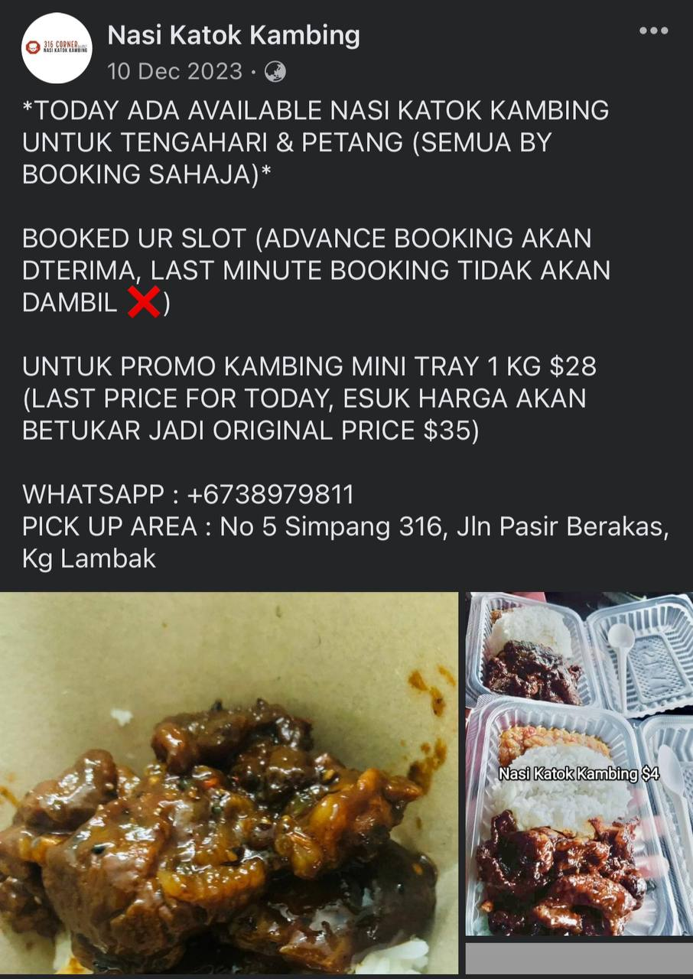
CARA MENGGUNAKAN NOTA DAN FACEBOOK
Notes:
Loan - where we can get loans - credibility (credit score

Slide 25
Mesej Utama
Pembuatan bajet adalah penting untuk menjejak pendapatan dan perbelanjaan, membolehkan pengurusan kewangan yang lebih baik.
Menjimatkan membolehkan kesiapan, pertumbuhan masa depan, dan keupayaan untuk mengharungi cabaran yang tidak dijangka.
Analisis kewangan secara berkala membantu menilai kesihatan kewangan perniagaan biskita dan membuat keputusan yang berinformasi.

Slide 26
MESEJ UTAMA
Menyimpan rekod yang tepat dan teratur adalah penting untuk kejayaan kewangan perniagaan biskita .
Pengukuran prestasi kewangan kunci membantu menilai keuntungan, kecekapan, kecairan, dan kebolehan syarikat, membantu dalam membuat keputusan dan memantau kesihatan kewangan.
Menganalisis penyata kewangan memberikan maklumat untuk membuat keputusan dan merancang strategi untuk perniagaan.

Slide 27
+673 818 5796
@brlifeagency
www.brlifeagency.com
with support from

