Slide 1




DIGITAL LITERACY
4. Social Media Basics
with support from

Slide 2
COURSE OUTLINE
1. ONLINE BASICS
2. STAYING SAFE
ONLINE
3. CYBERSECURITY
BASICS
4. SOCIAL MEDIA
BASICS
5. WEBSITE
BASICS
6. E-COMMERCE
BASICS

Slide 3

MODULE OBJECTIVES
SOCIAL MEDIA BASICS
As an entrepreneur, knowing where to promote your product or service is paramount to your success.
This section will look at how you can utilize social media platform to grow your customer base and reach your objectives.

Slide 4



MODULE OUTLINE
SOCIAL MEDIA BASICS
1. SOCIAL MEDIA MARKETING
2. CREATE A VISUAL AESTHETIC FOR YOUR BRAND
3. CONTENT CREATION BASICS

Slide 5
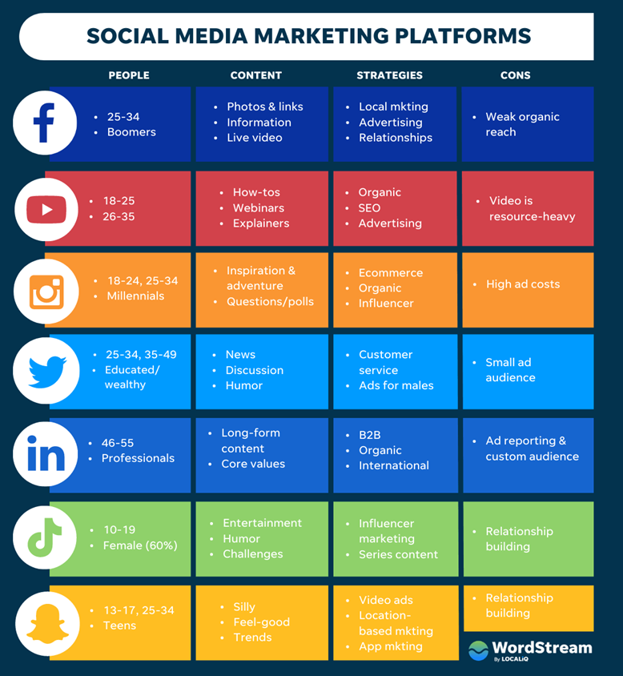
SOCIAL MEDIA MARKETING
What is Social Media Marketing?
The use of social media platforms to connect and interact with your audience to achieve your business goals (build your brand, increase sales, drive website traffic, etc)
Notes:
Social media has become a crucial platform for businesses of all sizes. All major brands are on social media because a majority of users turn to social media to look for products.
Social media marketing is the use of social media platforms to connect and interact with your audience to achieve your business goals e.g. build your brand, increase sales, and drive website traffic.
This involves publishing great content on your social media profiles, listening to and engaging your followers, analyzing your results, and running social media advertisements.
The major social media platforms (at the moment) are Facebook, Instagram, Twitter, LinkedIn, Pinterest, YouTube, and Snapchat.

Slide 6





SOCIAL MEDIA MARKETING
03 main questions help you select the platform
01
What are your goals?
02
Who is your audience?
03
How can you reach them?
  Increasing brand awareness
Who is your typical customer?
How old are they?
Are they men or women?
What is their income and education level?
What are their general interests in life?
What is their social media behavior?
Determine which platform your audience is using.
Social Media channel's user demographics and audience activity will help you choose the best platform for your brand
  Generate leads
  Reputation management
  Customer and audience engagement
  Customer service
Use the answers to create a buyer persona of your audience.
Notes:
With nearly half the world's population using some sort of social media, they are the natural place to interact with your existing customers and reach new targeted potential customers. However, you need to have a clear goal as to what you hope to use social media for to use it effectively.
Some of the goals you can aim for using social media for a business are:
Increasing Brand Awareness - When someone hears about your brand, or sees content that intrigues them, they will learn more about your brand, and your products or services indirectly. By having good engagement with your existing and potential customers, you will look out for the best interest of your customers and show that your product really work. Participating in these social interactions can also be a great way to increase your visibility, get attention from new people, showcase your expertise, and indirectly drive traffic to your website.
Generate Leads - A survey indicated that 60% of instagram users discover new products on the platform then purchase the product based on existing feedback and interaction that they see on the brand's social media presence. Social media offers a low commitment way for potential customers to express interest in your business by asking questions informally and without needing to go through official support channels.
Reputation Management - It is likely that your business is being talked about on social media by your customers, whether in a positive or negative light. Being on social media allows you to respond to these and highlight the positives as well as address any negative issues before it brews up to a major issue. If someone is sharing information about your business that is not true, you can share your side of the story politely and professionally. If someone is commending your business for a job well done, show that you are appreciative and draw attention for others to their kind words.
Customer and Audience Engagement - Social media provides the opportunity for businesses to interact directly with customers and fans, and vice versa. By staying active and responding to comments and questions on your social media posts, your audience will feel like the business cares about them and it isn't a one way street.
Customer Service - There will be complaints regarding your business on your social media. What matters is how you respond to these complaints. A Harvard Business Review research shows that customers who receive a response to their complaint would be willing to spend more on the brand in future purchases.

Slide 7

SOCIAL MEDIA MARKETING
Continuously Engage the Audience
Help you plan posts and make sure you don’t miss days to optimally manage your social media
Notes:
The content calendar is a big part of your strategy because it should lay out:
Who your audience is
What topics and subjects your audience is interested in
The usable content you already have
What kind of content you still need to create or curate
When and on what platforms content will be published

Slide 8

SOCIAL MEDIA MARKETING
Continuously Engage the Audience
  Commenting on posts
  Starting and participating in conversations
  Sharing relevant information
  Sharing user generated content
  Posting and answering questions
  Addressing complaints and criticisms
  Showing appreciation for customers
  Hosting live events that customers can participate in
Notes:
The content calendar is a big part of your strategy because it should lay out:
Who your audience is
What topics and subjects your audience is interested in
The usable content you already have
What kind of content you still need to create or curate
When and on what platforms content will be published

Slide 9
SOCIAL MEDIA MARKETING
Continuously Engage the Audience
The 70-20-10 rule
70%
Engaging, fun, free and useful information to your audience
20%
Exclusive, premium or inspiring content that highly viral
10%
Promotional content

Slide 10






SOCIAL MEDIA MARKETING
Manage Social Media
Social media management tools help you manage all of your social accounts in 01 location:

Slide 11
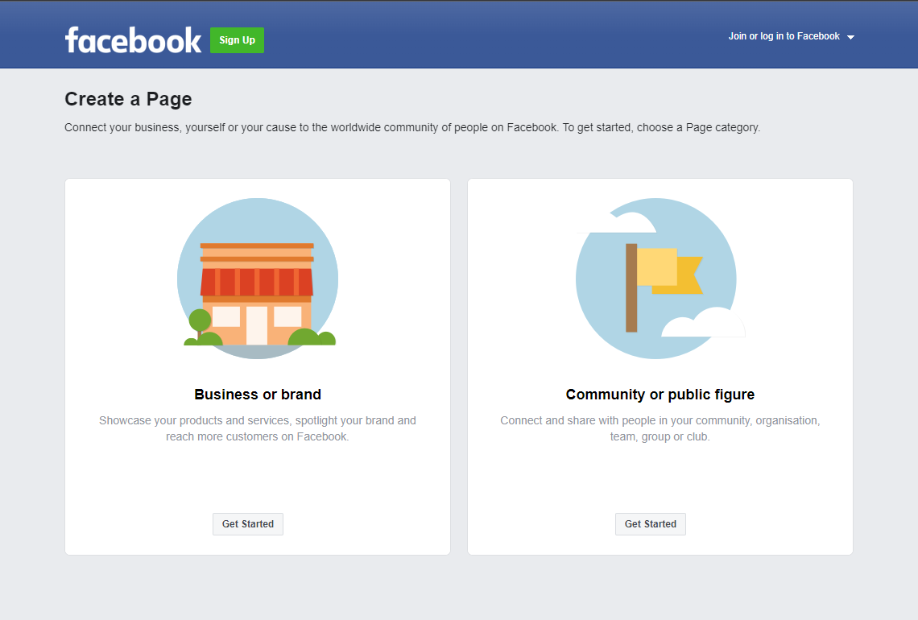
SOCIAL MEDIA MARKETING
LET’S PRACTICE!
Building a Facebook Marketing Strategy
Develop a comprehensive Facebook marketing strategy for your business

Slide 12
SOCIAL MEDIA MARKETING
LET’S PRACTICE!
SUGGESTED ANSWER
Building a Facebook Marketing Strategy
Define the target audience: Understand who your potential customers are - their age, gender, geographical location, and interests
Select the appropriate post types: Will you use images, videos, live streams, or create events to engage your audience?
Plan a content calendar: Plan when and what you will post. Remember to maintain a mix of promotional and value-based content.
Set KPIs: Define the metrics you'll use to measure the success of your strategy (likes, link clicks, or even sales conversions)
Before you can sign up for Facebook business page, you need to log into your personal Facebook account.
Go to facebook.com/pages/create for more information

Slide 13

SOCIAL MEDIA MARKETING
LET’S PRACTICE!
Getting Started with Instagram
Use all the components of Instagram account to their full advantage:
Name and username: the only parts of your Instagram profile that are included in Instagram search
Website: the only spot-on Instagram where you can post a clickable link
Contact information: include email address, phone number so fans can connect with you directly from your profile
Category: appears under your name and shows people at a glance what you do.
Call-to-action buttons: allow users to book an appointment, make reservations, buy tickets, and more, right from your Instagram profile
Go to instagram.com for more information
Notes:
More than 25 million companies worldwide are already using Instagram for business, and more than 200 million users visit at least one business profile every day.

Slide 14
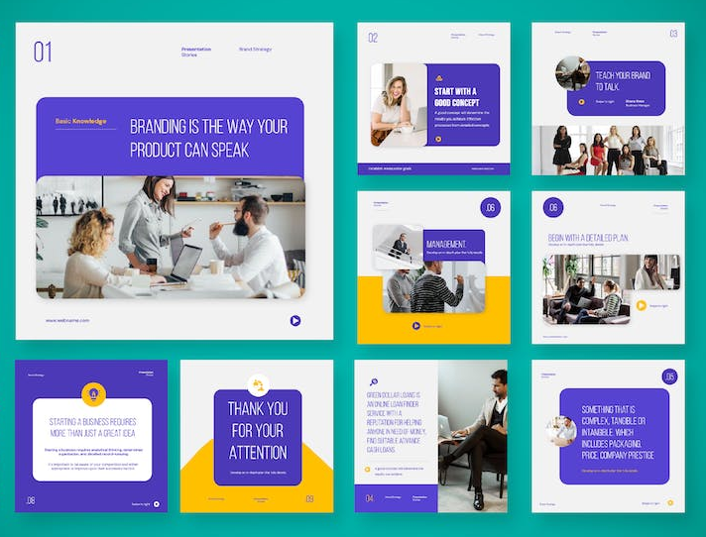
CREATE A VISUAL AESTHETIC FOR YOUR BRAND
Tips for creating a social media brand aesthetic:
Understand your business and audience persona
Seek inspiration from other brands
Choose a color palette that makes a statement
Pick your favorite filters and fonts
Create a toolkit for your aesthetic resources

Slide 15
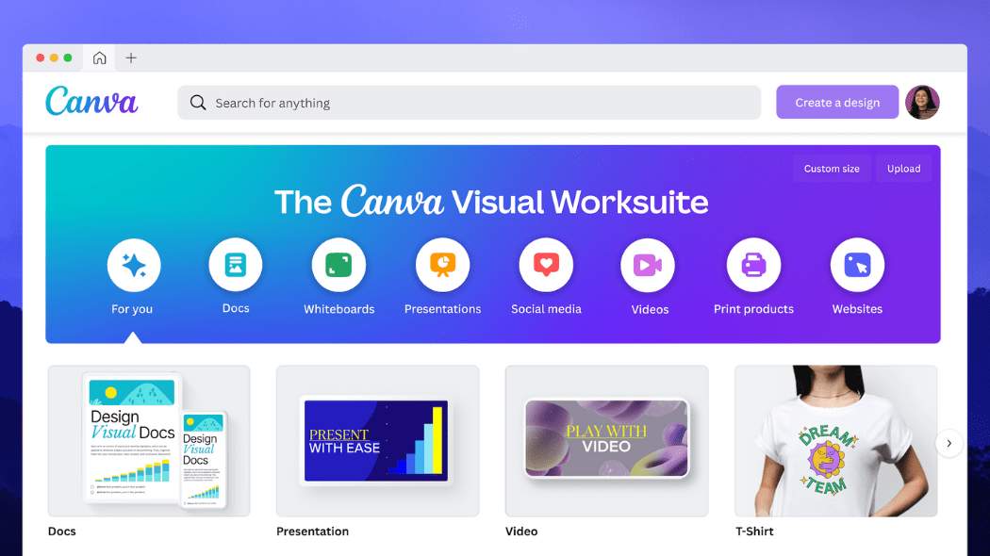
CREATE A VISUAL AESTHETIC FOR YOUR BRAND
LET’S PRACTICE!
First Design with Canva
Go to http://www.canva.com
Click Sign Up with Email to sign up for an account
Canva allows you to create all sorts of other graphic design such as posters or flyers and graphics for your business

Slide 16

CONTENT CREATION BASICS
Using Hashtag
A hashtag is a word or phrase that begins with the hash sign (#), used within a social media post to help others who might be interested in your topic find it when they search for a keyword or a hashtag.

Slide 17

CONTENT CREATION BASICS
Crafting your messages
Define your audience, they are reached in different ways.
Emotion + logic gets their attention.
Incorporating trending topics in your message, significantly increases engagement.
Consider not only what the message will say, but also how to say it in a concise manner that has the desired effect.

Slide 18
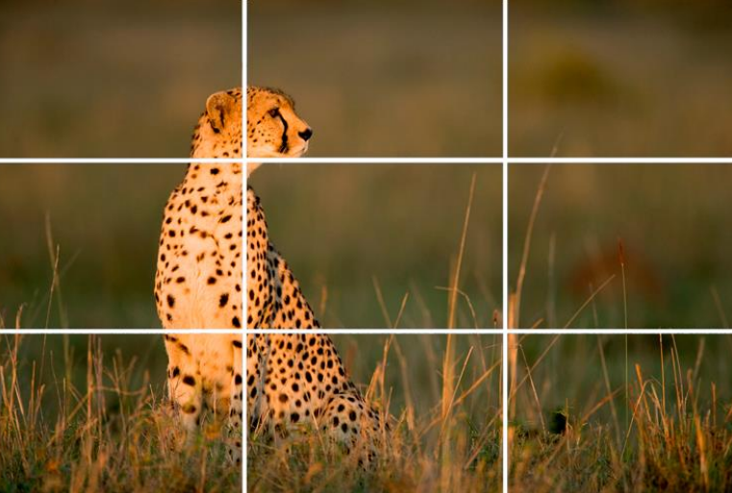
CONTENT CREATION BASICS
Visual media performs better than text
1/10 of a second is all it takes to understand a visual scene. 60 seconds is the average time it takes to read 200 - 250 words.
Rule of Thirds: compose shots so that points of interest align with an imaginary grid that divides the image into thirds vertically and horizontally.
Brighter images: images with a lot of white space/background space, single dominant color, low saturation, with a lot of texture.

Slide 19

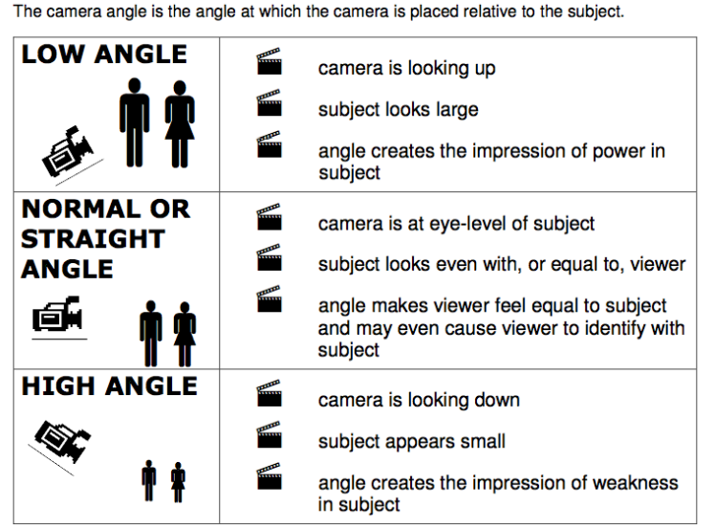


CONTENT CREATION BASICS
Camera angle
Camera is looking up
Subject looks large
Angle creates the impression of power in subject
Camera is at eye-level of subject
Subject looks even with, or equal to viewer
Angle makes viewer feel equal to subject and may even cause viewer to identify with subject
Camera is looking down
Subject appears small
Angle creates the impression of weakness in subject

Slide 20

CONTENT CREATION BASICS
LET’S PRACTICE!
Try writing an article promoting your product or service by applying the tips and rules you just learned

Slide 21
KEY MESSAGES
You are now ready to get your business onto the various social media platforms that have been discussed here!
Learn how to manage social media marketing
Know how to create a visual aesthetic for your brand
Identify basic tips for creating content

Slide 22





APPENDIX
Extra: Content revolution
Text
Picture
Video
Interactive
Content
Augmented
Reality

Slide 23
with support from

