Slide 1




DIGITAL LITERACY
5. Website Basics
with support from

Slide 2
COURSE OUTLINE
1. ONLINE BASICS
2. STAYING SAFE
ONLINE
3. CYBERSECURITY
BASICS
4. SOCIAL MEDIA
BASICS
5. WEBSITE
BASICS
6. E-COMMERCE
BASICS

Slide 3
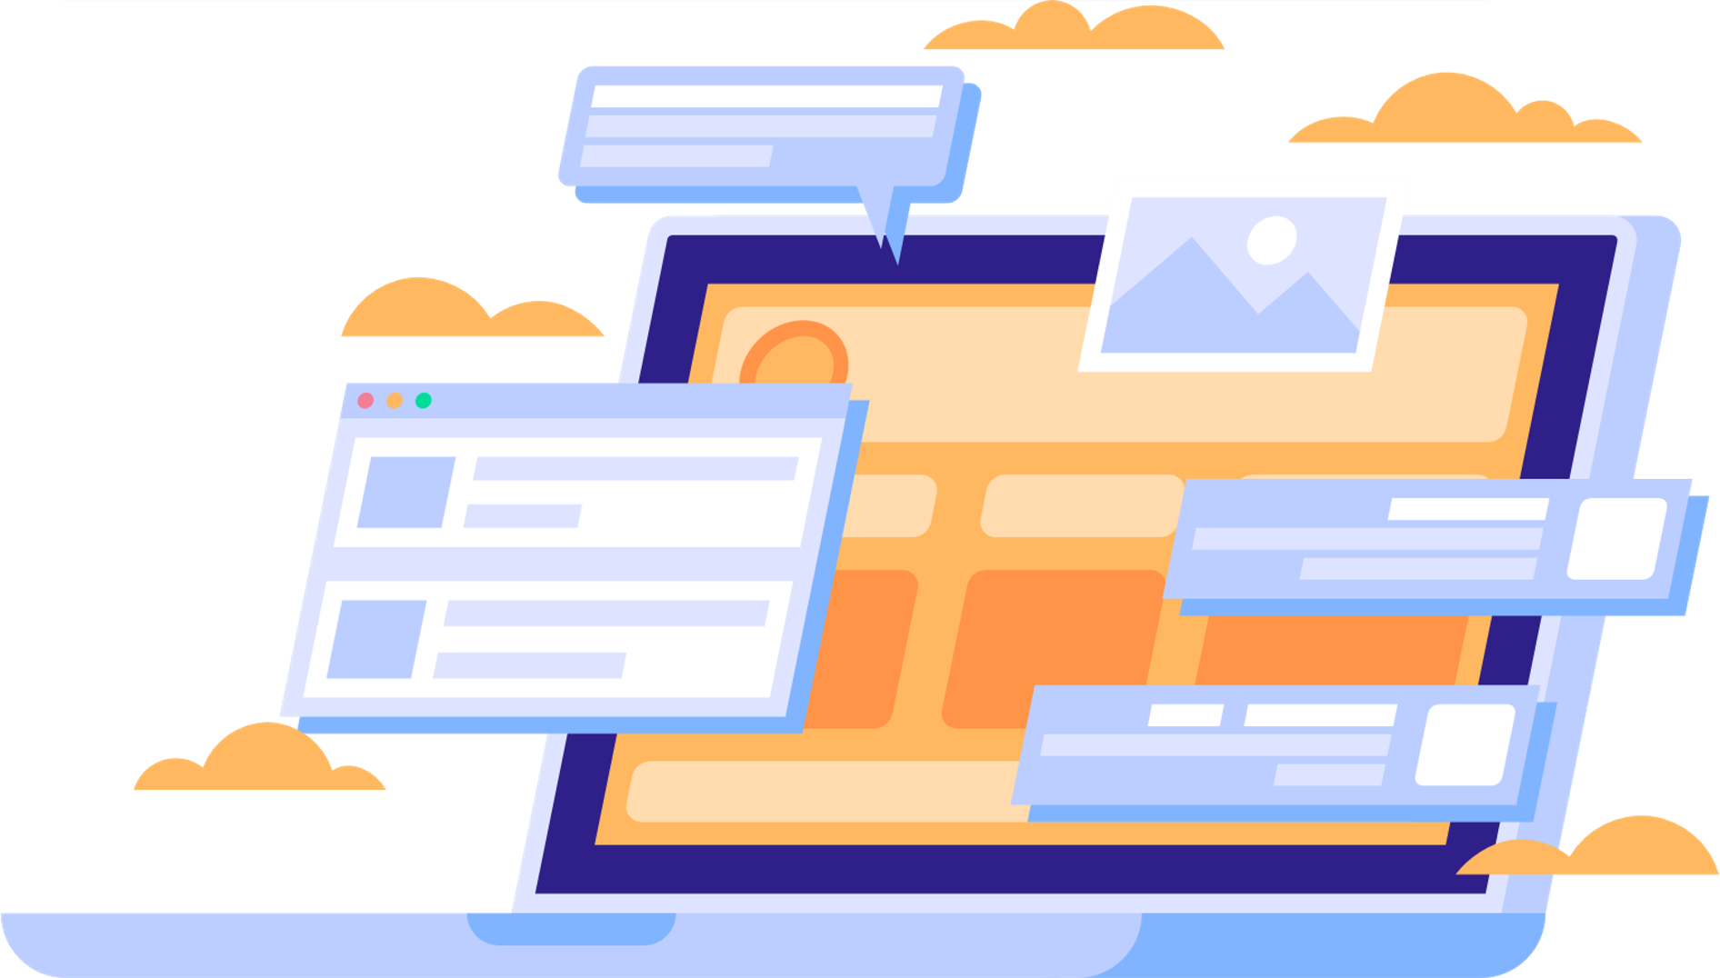
MODULE OBJECTIVES
WEBSITE BASICS
As an entrepreneur, knowing where to promote your product or service is paramount to your success.
This section will look at how you can utilize a website to grow your customer base and reach your objectives.

Slide 4
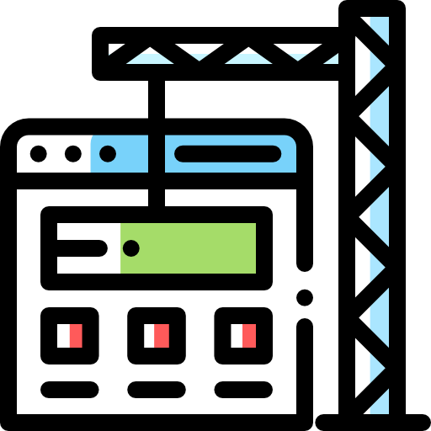
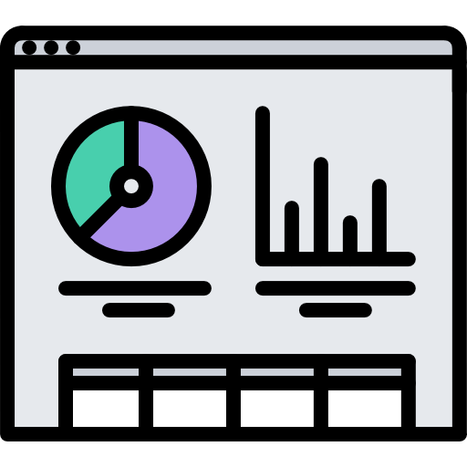


MODULE OUTLINE
WEBSITE BASICS
1. BUILDING A WEBSITE
2. SITE METRICS
3. WEB PRESENCE
4. SEARCH ENGINE MARKETING

Slide 5

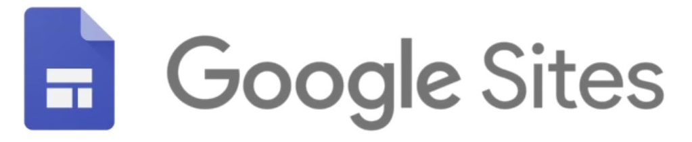



BUILDING A WEBSITE
Why does your business need a website?
Website acts as a platform for your messaging and shapes the online perception of your business.
Websites with relevant content attract visitors, promote actions, and turn visitors into satisfied customers who can become your best promoters.
Your website belongs to you, if you are using social media, you’ll always be dependent on the platform you choose.
Examples of free website builder
Notes:
In this day and age where more than half of world population is online, websites have become essential to business.
Some businesses don’t have a website because they feel that they don’t have the skill, don’t understand how to manage a website, a website is expensive to build, don’t need one because they use social media instead, etc.
Why does your business need a website?
Website acts as a platform for your messaging and shapes the online perception of your business. If you have a website, it belongs to you, and you control the content and the message. If you are using social media, you’ll always be dependent on the platform you choose.
Websites with relevant content attract visitors, promote actions, and turn visitors into satisfied customers who can become your best promoters.
You can improve your website over time, but the key is to start now.
Let’s add Google Sites to your digital toolbox.

Slide 6




BUILDING A WEBSITE
Basic Terms
Websites: files stored on servers, which are computers that host (“store files for”) websites. These servers are connected to a network called the internet
Browsers: computer programs that load the websites via your internet connection, such as Google Chrome or Mozilla Firefox
Domain name with a top level domain (TLD): acts as an address that you can provide to someone who wants to visit your website
Hypertext Transfer Protocol (HTTP): is used to load web pages using hypertext links & Hypertext Transfer Protocol Security (HTTPS) is a secure way to send data between a web server and a web browser
You can register a domain name with a domain name registrar such as NameCheap or GoDaddy
https://www.google.com
Ex: google is the domain name and TLD is .com

Slide 7
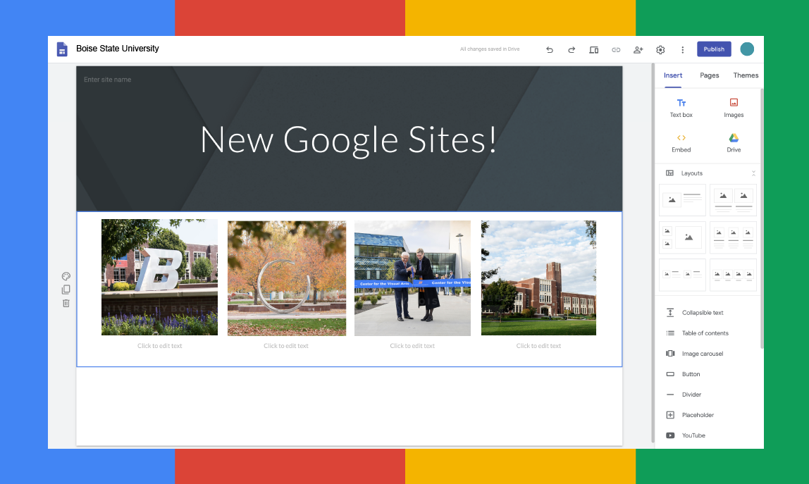
BUILDING A WEBSITE
LET’S PRACTICE!
Creating Your First Google Site
Google Sites is a free webpage creation and publishing platform by Google.
Example: sites.google.com/view/yoursite
Go to Google Sites.

Slide 8
SITE METRICS
Traffic means you have people visiting your website
Website metrics are how you measure your site's performance
Understand your website's metrics helps you know if your website is performing for your goal
Notes:
One of the main reasons people build a website is so that you can drive traffic to your website so your business becomes more well known and accessible by many.

Slide 9
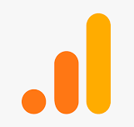
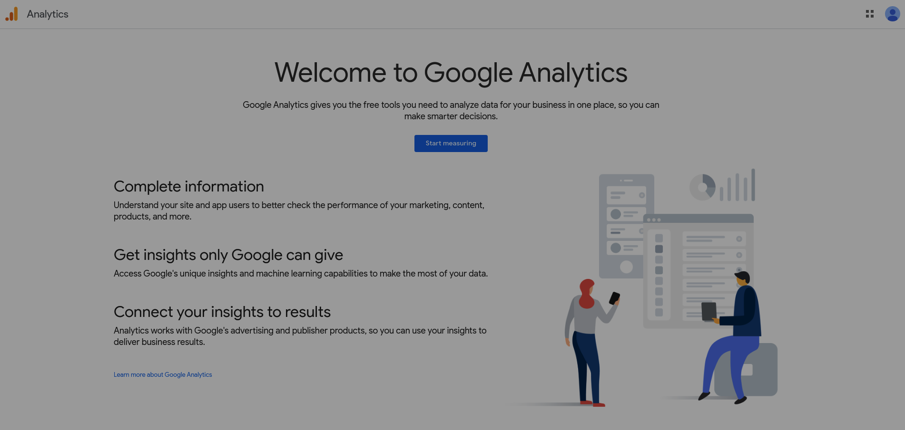
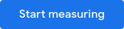
SITE METRICS
LET’S PRACTICE!
Google Analytics
Google Analytics is a free tool that you can embed into your website so you can get statistics about your website's traffic and its visitors.
Go to Google Analytics, and click "Start measuring"
Type in a new account name and click Next.
Set up GA parameters
Insert GA code into your website body and start tracking

Slide 10
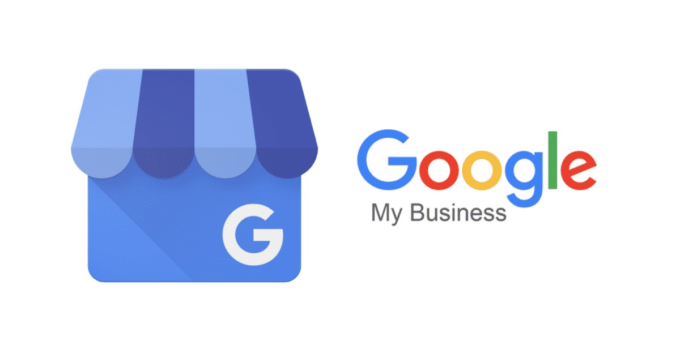
WEB PRESENCE
Besides a website, you would want to establish a web presence by making yourself searchable where people are likely to find you.
A Google My Business account lets you show up directly in Google's search results:
Where your business is located
Accurate contact information
Business hours
Customers would be able to leave reviews, which also help build trust.
Notes:
Besides a website, you would want to establish a web presence by making yourself searchable where people are likely to find you.
Search engines like Google does index your website and its contents, but where you appear as part of the search index depends on a number of factors such as how relevant your site is.
A Google My Business account lets you show up directly in Google's search results and Google Maps when people are looking for you.
Once they do, your listing can show where your business is located, whether you have a web or physical address. Because Google understands your locality, Google will show you as being more relevant the closer you are to them.
You can also include accurate contact information, business hours, and other essential details, and update people who are searching for you if you’ve expanded services, temporarily closed, or fully reopened.
Customers would be able to leave reviews, which also help build trust. Research by Think With Google finds that 88% of consumers trust online reviews as much as personal recommendations. If your customers are unable to find the information about you, they might be relying on a third party review site with questionable source of that information.

Slide 11
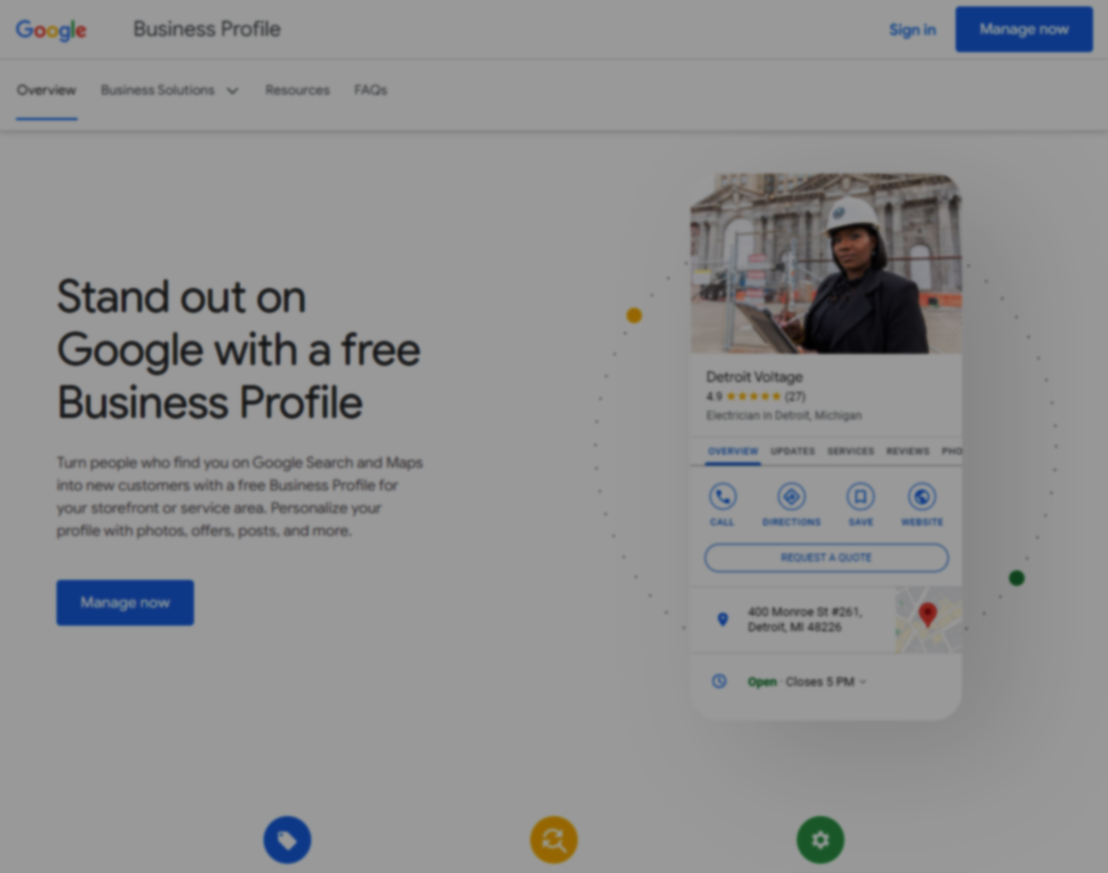
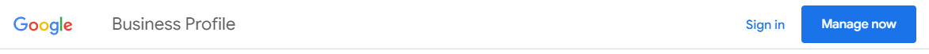
WEB PRESENCE
LET’S PRACTICE!
Setting up
Go to Google My Business > sign in

Slide 12
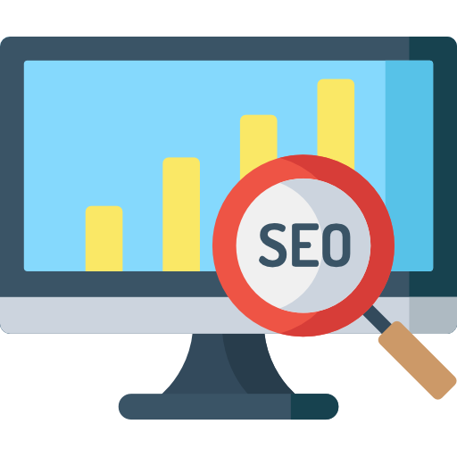

SEARCH ENGINE MARKETING
Search engine marketing is the process of improving the prospects of your customers discovering your website via search engines.
Organic Listing – Search engine optimization (SEO): organic search strategy, free but take time to generate organic traffic
Paid Listing – Search engine marketing (SEM): paid search strategy – paid adverts

Slide 13
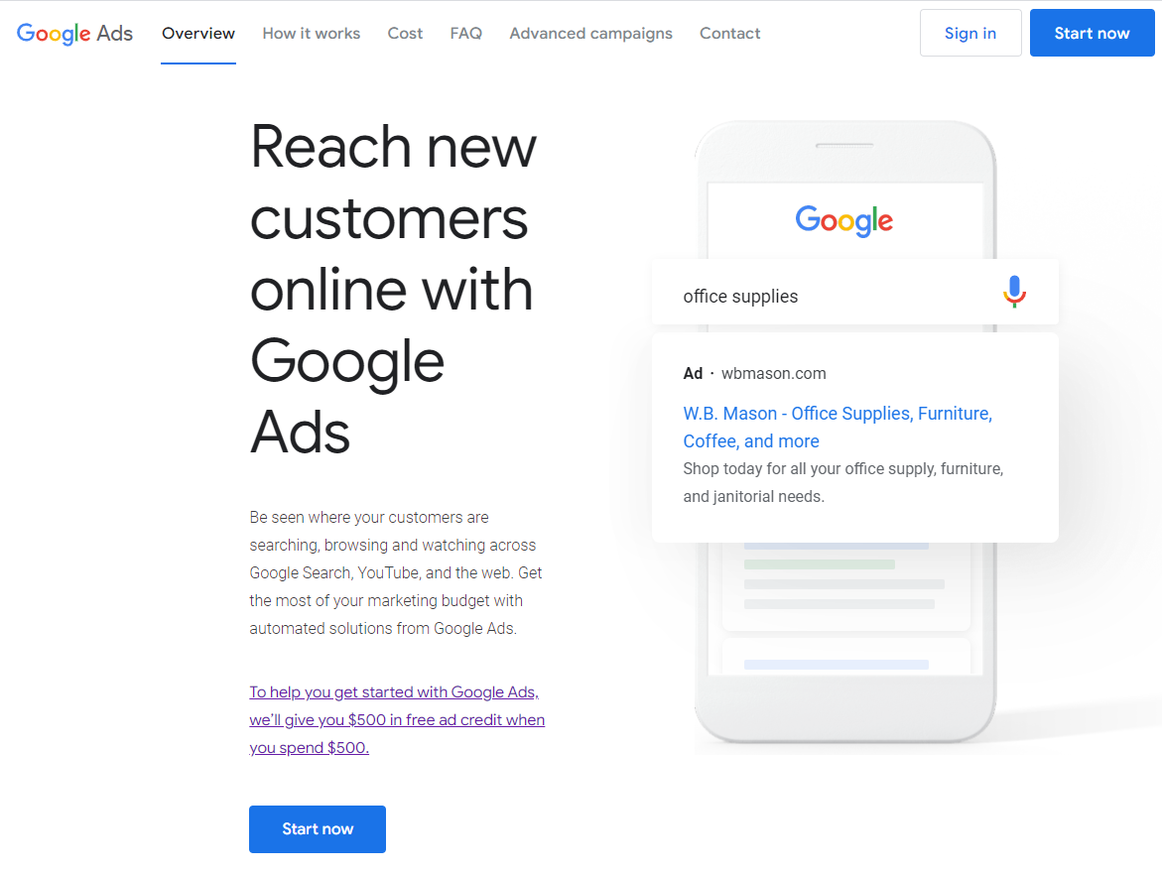
SEARCH ENGINE MARKETING
LET’S PRACTICE!
Set Up with AdWords
Google AdWords is an ad platform that you can use to use Search Engine Marketing on Google Search
Go https://ads.google.com/home/
Notes:
Google Ads is far and away the most popular platform for hosting search engine ads. Consider other opportunities, too, such as Bing ads, Yahoo search ads, and Amazon-sponsored ads for the right industries. If you have a target market in China, put an ad on Baidu.

Slide 14
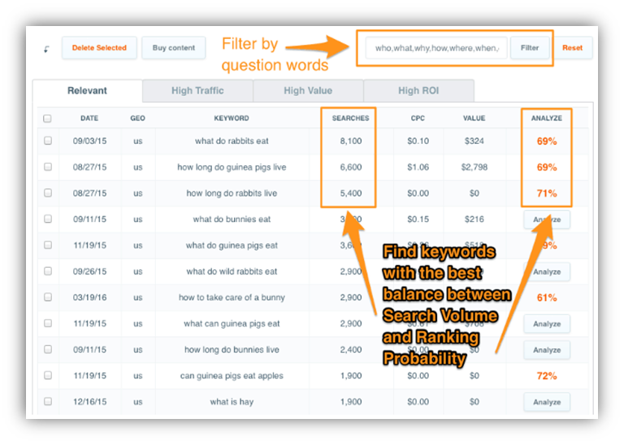
CASE STUDY
PROBLEM
Mr. X realised that customers would google “where to find food for Hamster” rather than go to any general store
CHALLENGES
  Attracting these potential customers to his website by leveraging Google's search engine, thus increasing organic traffic and sales
BUILD ORGANIC TRAFFIC WITH KEYWORD PLANNER

Slide 15
CASE STUDY
SOLUTION
Utilizing Google's Keyword Planner to identify keywords related to hamster food, taking into account search volume, ranking probability, and cost-per-click (CPC)
Creating informative blog posts on his website using these keywords, such as "Do Guinea Pigs eat strawberries?" or “Should we let Guinea Pigs eat strawberry?”
Participating in online forums, discussion boards, and Q&A platforms to find similar question and start to answer them leading backlink to his website
BUILD ORGANIC TRAFFIC WITH KEYWORD PLANNER

Slide 16
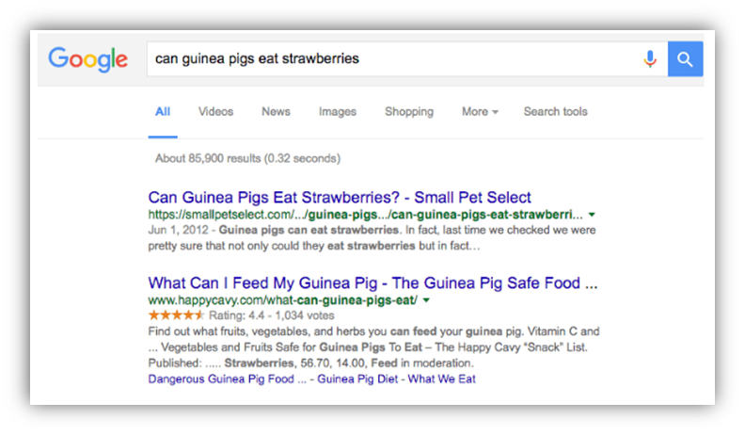
CASE STUDY
RESULT
After 3 weeks, Mr. X’s original article jumped to top page in Google search
Over the next 6 months, his website traffic increased six-fold and sales quadrupled
=> Further establishing his expertise in pet care
LESSON LEARNED
  Demonstrating the power of effective SEO practices and content marketing in driving organic traffic and increasing sales
  Engaging in online communities helps to build credibility and authority in a specific field
BUILD ORGANIC TRAFFIC WITH KEYWORD PLANNER

Slide 17

KEY MESSAGES
Congratulations! Now you have an idea of website basics, how about trying to build your first website for your business:
Build a basic website
Study site metrics
Establish a web presence
Use search engine marketing

Slide 18
APPENDIX
Acquisition
Activation
Retention
Revenue
Referral
Where is the traffic to the website coming from?
What do your users do once they get to the website?
How often are users coming back to your website?
How do you make money?
How many people are sharing your website?
If you notice that 60% of the web traffic is coming from one article on a major food blog, you know their target audience is the same as yours. You can then try to reach out to that food blog to try and collaborate so that you can get more exposure to your target audience.
If you notice that many visitors are leaving without clicking on any links (bounce rate is high), maybe people aren’t scrolling down to read the rest of the landing page. You can try changing the copy of the headline and the wording in the sales page to grab the attention of the reader.
If you notice that on average, it takes a paying customer 3 re-visits before purchasing your book, you could use search engine marketing to retarget your customer by showing ads to users who already visited your website.
You might notice that your most popular blog post is a recipe for chicken curry. Based on this information, you could interview customers and find out how many of them would also buy a curry recipe book.
You might notice referrals from social media have a higher conversion rate, and most people are sharing pictures of meals from your recipe. You create a photo sharing contest encouraging customers to share photos of their chicken curry and to tag your website.

Slide 19
with support from

